Slide 1

Business Case Insert Project Name
Confidential
Author: insert your own text
Project Sponsor: insert your own text
Project Manager: insert your own text
Change Manager: insert your own text
Date: insert your own text
Version No: insert your own text
Status: E.g. 1.0 for final / 0.1 for drafts
Insert your own logo

Slide 2
Document Purpose
The purpose of this document is to provide enough information on the potential project “insert project name” to decide whether or not to invest in it. This document will provide an overview of the following:
Business Opportunity & Suggested Solution
Project Objectives, Scope & Approach
Project Deliverables & Business Outcomes
Strategic Alignment
Dependencies & Constraints
Risk Assessment & Mitigation
Change Impact Assessment
Project Costs
Benefits
Net Present Value
Key Success Factors & KPIs
Most of companies have either a very complex Business Case Template that nobody uses, or a Business Case Template which is not good enough to make robust decisions on whether or not to invest.
Following the requests of many of our clients, we decided to solve this problem by creating a Business Case Template which is both comprehensive and simple to use.

Slide 3
Document Audience
Name | Role | Required / Optional
John Doe | Project Sponsor | Required
Insert Name | Insert role | Insert Required or Optional
Insert Name | Insert role | Insert Required or Optional
Insert Name | Insert role | Insert Required or Optional
Insert Name | Insert role | Insert Required or Optional
Insert Name | Insert role | Insert Required or Optional
Insert Name | Insert role | Insert Required or Optional

Slide 4

Table of Contents
Executive Summary
Business Opportunity & Suggested Solution
Project Objectives, Scope & Approach
Project Deliverables & Business Outcomes
Strategic Alignment
Dependencies & Constraints
Risk Assessment & Mitigation
Change Impact Assessment
Project Costs
Benefits
Net Present Value
Key Success Factors & KPIs
Exhibits

Slide 5
Table of Contents
Executive Summary
Business Opportunity & Suggested Solution
Project Objectives, Scope & Approach
Project Deliverables & Business Outcomes
Strategic Alignment
Dependencies & Constraints
Risk Assessment & Mitigation
Change Impact Assessment
Project Costs
Benefits
Net Present Value
Key Success Factors & KPIs
Exhibits

Slide 6
Lean Business Case Project name: Project description:
This Lean Business Case is very important, as your CEO and Senior executives may not have time to deep dive into more details. It is the first section of the Business Case, but it is often done at the end.
Project Costs
$4M
Tangible Benefits
$14M
Net Present Value
$8M
Cash Flow (US $ millions)
Change Impact
Intangible Benefits
Insert your own text
Strategic Alignment
Insert the Strategic Objectives that the project is aligned with
High Impact
Number of Resources
12
Project Sponsor
John Doe
Project Manager
John Doe
Change Manager
John Doe

Slide 7
Table of Contents
Executive Summary
Business Opportunity & Suggested Solution
Project Objectives, Scope & Approach
Project Deliverables & Business Outcomes
Strategic Alignment
Dependencies & Constraints
Risk Assessment & Mitigation
Change Impact Assessment
Project Costs
Benefits
Net Present Value
Key Success Factors & KPIs
Exhibits

Slide 8
Business Opportunity & Suggested Solution Replace this text by the key takeaway of this slide
For some project, you may need more than one slide to express the Business Opportunity and suggested solution. However, we recommend to be straight to the point
Business Opportunity
Suggested Solution
Describe in this text block the main Business Opportunity that you identified
Describe in this text block the Solution you suggest

Slide 9
Table of Contents
Executive Summary
Business Opportunity & Suggested Solution
Project Objectives, Scope & Approach
Project Deliverables & Business Outcomes
Strategic Alignment
Dependencies & Constraints
Risk Assessment & Mitigation
Change Impact Assessment
Project Costs
Benefits
Net Present Value
Key Success Factors & KPIs
Exhibits

Slide 10
Project Objectives Replace this text by the key takeaway of this slide
The best practice used by our Management Consultant is to summarize the slide in the second sub headline. That way, if your CEO or Executives don’t have time, they can understand the presentation by mainly focusing on the headlines and subhead lines
Insert Objective
Insert Objective
Insert Objective

Slide 11
Project Scope Replace this text by the key takeaway of this slide
The categories may vary a lot depending on your Business
Category | In Scope | Out of scope
Strategy | Insert your own description | Insert your own description
Products | Insert your own description | Insert your own description
Processes | Insert your own description | Insert your own description
Systems | Insert your own description | Insert your own description
Channels | Insert your own description | Insert your own description
Roles | Insert your own description | Insert your own description
Insert Category name | Insert your own description | Insert your own description

Slide 12
Project Structure Replace this text by the key takeaway of this slide
Insert Name
Project Manager
Insert Name
Insert Role
We added in the next slides more organizational charts. Feel free to use the one that best suits your needs
Insert Name
Insert Role
Insert Name
Insert Role
Insert Name
Insert Role
Insert Name
Insert Role
Insert Name
Insert Role
Insert Name
Insert Role
Insert Name
Insert Role

Slide 13
Organizational Charts
Label
Line 1
Line 2
Label
Label
Label
Line 1
Line 2
Line 1
Line 2
Line 1
Line 2

Slide 14

Organizational Charts
Insert title
Describe responsibility #1
Describe responsibility #1
Describe responsibility #1
Insert title
Describe responsibility #1
Describe responsibility #1
Describe responsibility #1
Insert title
Describe responsibility #1
Describe responsibility #1
Describe responsibility #1
Insert title
Describe responsibility #1
Describe responsibility #1
Describe responsibility #1

Slide 15

Organizational Charts
Insert title
Describe responsibility #1
Describe responsibility #1
Describe responsibility #1
Insert title
Describe responsibility #1
Describe responsibility #1
Describe responsibility #1
Insert title
Describe responsibility #1
Describe responsibility #1
Describe responsibility #1
Insert title
Describe responsibility #1
Describe responsibility #1
Describe responsibility #1

Slide 16
Organizational Charts
Insert title
Insert title
Insert title
Insert title
Insert title
Insert title
Insert title
Insert title

Slide 17
Organizational Charts
Sample Text
Sample Text
Sample Text
Sample Text
Sample Text
Sample Text
Sample Text
Sample Text
Sample Text
Sample Text
Sample Text
Sample Text
Sample Text
Sample Text
Sample Text
Sample Text
Sample Text
Sample Text
Sample Text
Sample Text
Sample Text
Sample Text

Slide 18
Organizational Charts
Sample Text
Sample Text
Sample Text
Sample Text
Sample Text
Sample Text
Sample Text
Sample Text
Sample Text
Sample Text
Sample Text
Sample Text
Sample Text
Sample Text
Sample Text
Sample Text
Sample Text
Sample Text
Sample Text
Sample Text
Sample Text
Sample Text

Slide 19
Project Approach Replace this text by the key takeaway of this slide
= Key deliverable
Week | 1 | 2 | 3 | 4 | 5 | 6 | 7 | 8 | 9 | 10 | 11 | 12
Starts on | 7/1 | 14/1 | … | … | … | … | … | … | … | … | … | …
Insert name of Phase 1
1.1 Insert name of Activity
1.2 Activity
1.3 Activity
Phase 2
2.1 Activity
2.2 Activity
2.3 Activity
Phase 3
3.1 Activity
3.2 Activity
3.3 Activity
This slide should be high level.

Slide 20
Table of Contents
Executive Summary
Business Opportunity & Suggested Solution
Project Objectives, Scope & Approach
Project Deliverables & Business Outcomes
Strategic Alignment
Dependencies & Constraints
Risk Assessment & Mitigation
Change Impact Assessment
Project Costs
Benefits
Net Present Value
Key Success Factors & KPIs
Exhibits

Slide 21

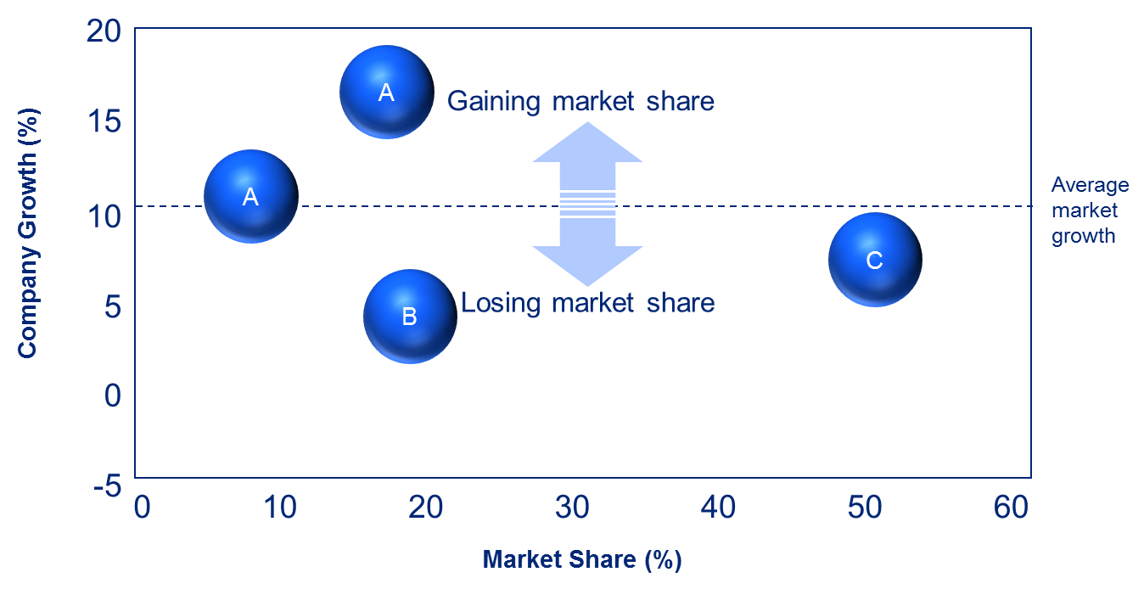
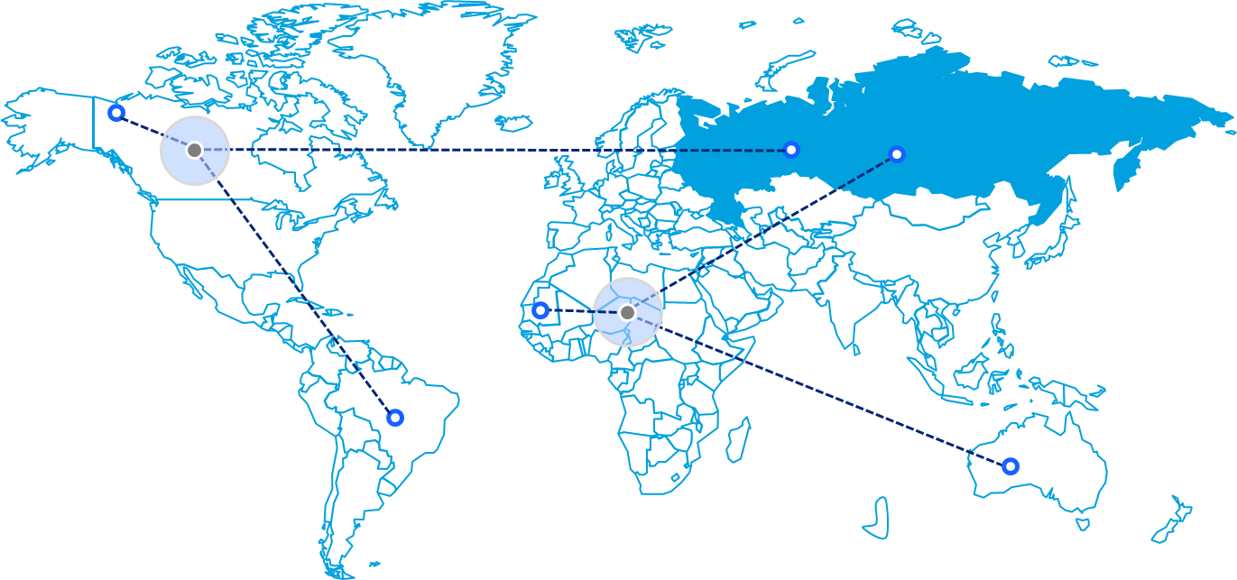
Project Deliverables and Business Outcomes Zoom on phase 1
1
2
3
Objectives
Replace this text by your own text
Replace this text by your own text
Replace this text by your own text
Key Business Outcomes
Replace this text by your own text
Replace this text by your own text
Replace this text by your own text
Deliverable examples
Replace this images by images of your own deliverables, so your stakeholders can better imagine what will be done
Key Activities & Milestones
Replace this text by your own text
Replace this text by your own text
Replace this text by your own text
Replace this text by your own text
Key Deliverables
Replace this text by your own text
Replace this text by your own text
Replace this text by your own text

Slide 22
Project Deliverables and Business Outcomes Zoom on phase 2
1
2
3
Objectives
Replace this text by your own text
Replace this text by your own text
Replace this text by your own text
Key Business Outcomes
Replace this text by your own text
Replace this text by your own text
Replace this text by your own text
Deliverable examples
Key Activities & Milestones
Replace this text by your own text
Replace this text by your own text
Replace this text by your own text
Replace this text by your own text
Key Deliverables
Replace this text by your own text
Replace this text by your own text
Replace this text by your own text

Slide 23
Project Deliverables and Business Outcomes Zoom on phase 3
1
2
3
Objectives
Replace this text by your own text
Replace this text by your own text
Replace this text by your own text
Key Business Outcomes
Replace this text by your own text
Replace this text by your own text
Replace this text by your own text
Deliverable examples
Key Activities & Milestones
Replace this text by your own text
Replace this text by your own text
Replace this text by your own text
Replace this text by your own text
Key Deliverables
Replace this text by your own text
Replace this text by your own text
Replace this text by your own text

Slide 24
Table of Contents
Executive Summary
Business Opportunity & Suggested Solution
Project Objectives, Scope & Approach
Project Deliverables & Business Outcomes
Strategic Alignment
Dependencies & Constraints
Risk Assessment & Mitigation
Change Impact Assessment
Project Costs
Benefits
Net Present Value
Key Success Factors & KPIs
Exhibits

Slide 25
Strategic Alignment Replace this text by the key takeaway of this slide
Caption:
Strategic Objectives the Project is aligned with
Mission
Your company or your client should have a “Strategy on a page” including the main Strategic Objectives. If not, feel free to reuse this slide.
If there is not clear Strategic alignment between the project and the Vision and Strategy of the Company, the Project should not go ahead.
Insert your Mission statement
Vision
Insert your Vision statement
Strategic Objectives
Insert the name of a Strategic Objective
Insert the name of a Strategic Objective
Insert the name of a Strategic Objective
Insert the name of a Strategic Objective
Insert the name of a Strategic Objective
Insert the name of a Strategic Objective
Insert the name of a Strategic Objective
Insert the name of a Strategic Objective
Insert the name of a Strategic Objective
Insert the name of a Strategic Objective
Insert the name of a Strategic Objective
Insert the name of a Strategic Objective

Slide 26
Table of Contents
Executive Summary
Business Opportunity & Suggested Solution
Project Objectives, Scope & Approach
Project Deliverables & Business Outcomes
Strategic Alignment
Dependencies & Constraints
Risk Assessment & Mitigation
Change Impact Assessment
Project Costs
Benefits
Net Present Value
Key Success Factors & KPIs
Exhibits

Slide 27
Dependencies Replace this text by the key takeaway of this slide
ID | Description | Impact | Dependency Deliverer | Agreed Action | Agreed Delivery Date
D1 | The project require the delivery of customer data from project XYZ | If data delivery not one time, the whole project will be delayed | John Doe (IT Manager) | The project XYZ will deliver the data before the agreed delivery date | June 20
D2 | Insert your own text | Insert your own text | Insert your own text | Insert your own text | Insert your own text
D3 | Insert your own text | Insert your own text | Insert your own text | Insert your own text | Insert your own text
D4 | Insert your own text | Insert your own text | Insert your own text | Insert your own text | Insert your own text
D5 | Insert your own text | Insert your own text | Insert your own text | Insert your own text | Insert your own text
D6 | Insert your own text | Insert your own text | Insert your own text | Insert your own text | Insert your own text
D7 | Insert your own text | Insert your own text | Insert your own text | Insert your own text | Insert your own text
D8 | Insert your own text | Insert your own text | Insert your own text | Insert your own text | Insert your own text

Slide 28
Constraints Replace this text by the key takeaway of this slide
ID | Constraints Name | Description
C1 | E.g. Availability of fund | No more than $10M can be allocated to this project
C2 | Insert your own text | Insert your own text
C3 | Insert your own text | Insert your own text
C4 | Insert your own text | Insert your own text
C5 | Insert your own text | Insert your own text
C6 | Insert your own text | Insert your own text
C7 | Insert your own text | Insert your own text
C8 | Insert your own text | Insert your own text

Slide 29
Table of Contents
Executive Summary
Business Opportunity & Suggested Solution
Project Objectives, Scope & Approach
Project Deliverables & Business Outcomes
Strategic Alignment
Dependencies & Constraints
Risk Assessment & Mitigation
Change Impact Assessment
Project Costs
Benefits
Net Present Value
Key Success Factors & KPIs
Exhibits

Slide 30
Risk Assessment and Mitigation Replace this text by the key takeaway of this slide
Risk # | Risk Title | Risk description | Probability | Impact | Mitigation
1 | Lower website speed | Improving the resolution of our images will increase the size of our images, which may lower our website page loading time | Likely | Major | Find a tool that compresses the image size without altering quality
2 | Insert your risk title | Insert your risk description | Insert your own text | Insert your own text | Insert your risk description
3 | Insert your risk title | Insert your risk description | Insert your own text | Insert your own text | Insert your risk description
4 | Insert your risk title | Insert your risk description | Insert your own text | Insert your own text | Insert your risk description
5 | Insert your risk title | Insert your risk description | Insert your own text | Insert your own text | Insert your risk description
6 | Insert your risk title | Insert your risk description | Insert your own text | Insert your own text | Insert your risk description
7 | Insert your risk title | Insert your risk description | Insert your own text | Insert your own text | Insert your risk description
In the next 2 slides, we added a scale to help you identify the probability and impact of a risk. Based on the expertise of your stakeholders, you may decide to add the next 2 slides in the exhibit section of your Business Case Template

Slide 31
Risk Assessment Matrix The scale below can be used to assess the probability of a risk to happen
Probability Scale & Definition
Probability Scale
Definition
Almost certain
Above 90% of chances to happen
Likely
Between 60% and 90% of chances to happen
Possible
Between 20% and 60% of chances to happen
Unlikely
Between 5% and 20% of chances to happen
Rare
Less than 5% of chances to happen

Slide 32
Risk Assessment Matrix The scale below can be used to assess the potential impact of a risk
“Impact” Scale & Definition
Impact Scale
Definition
Severe
Risk will cause Project failure or Company failure
Major
Risk will impact project success or company success
Moderate
Risk may impact project success or company success
Minor
Barely no impact on project success or company success
Marginal
No impact on project success or company success

Slide 33
Table of Contents
Executive Summary
Business Opportunity & Suggested Solution
Project Objectives, Scope & Approach
Project Deliverables & Business Outcomes
Strategic Alignment
Dependencies & Constraints
Risk Assessment & Mitigation
Change Impact Assessment
Project Costs
Benefits
Net Present Value
Key Success Factors & KPIs
Exhibits

Slide 34
Change Impact Assessment Replace this text by the key takeaway of this slide
Caption:
Low
Moderate
Medium
High
Extreme
I. Executive Summary
Complexity of the change
Insert in this grey box a summary of what will be impacted by the change
Size of the change
Insert a summary of which groups of people will be impacted by the change
II. What will be impacted by the change?
III. Which groups of people will be impacted by the change?
Type of change
Description
Impact intensity
Group name
Description
Impact intensity
People increase / reduction
Insert your own description
Business unit 1
Insert your own description
System
Insert your own description
Business unit 2
Insert your own description
Process
Insert your own description
Business unit 3
Insert your own description
Role
Insert your own description
Business unit 4
Insert your own description
Structure
Insert your own description
Business unit 5
Insert your own description
Culture
Insert your own description
Business unit 6
Insert your own description

Slide 35
Change Impact Assessment Replace this text by the key takeaway of this slide
Caption:
Low Impact
Moderate Impact
Medium Impact
High Impact
Extreme Impact
Extreme
Insert name of the Change
High
In the next slide, we added a scale to help you identify the probability and impact of a risk. Based on the expertise of your stakeholders, you may decide to add the next 2 slides in the exhibit section of your Business Case Template
Complexity of the Change
Medium
Moderate
Low
1 team impacted
1 Business Unit
1 Division
Half of the Company
Extreme
Size of the Change

Slide 36
Change Impact Assessment Scale
Low
Moderate
Medium
High
Extreme
Size of the change
1 team impacted
1 Business Unit
1 Division
Half of the Company
Every employee
Complexity of the change
The Complexity of the change depends on how we rated the impact intensity of the “People increase / reduction” change, “System” change, “Process” change, “Organization structure” change and “Culture” change (see below)
1. People increase / reduction change
There are low reductions in headcount predicted (~1 FTE), but natural attrition will account for the numbers
There are reductions in headcount predicted, but natural attrition will account for the numbers
There are reductions in headcount predicted but contractors will account for the numbers
There is a significant reduction in headcount predicted. Redeployment & redundancies will need to be factored in
There is a large headcount reduction required as part of this change. Significant effort will need to be invested in redeployment / redundancy
2. System change
Almost no change
Minor changes/enhancements to functionality in an existing system, that is low risk and non critical
Major changes/enhancements to functionality in an existing system that is business critical but not customer facing
New technology is being introduced, but the key concepts and functionality are not too dissimilar to the old system. System is customer facing and has the potential to create external exposure if the change is managed poorly
New technology is being introduced which requires bringing a new way of thinking to an existing task. System is customer facing and has the potential to create external exposure if the change is managed poorly
3. Process change
Almost no change to current processes
Some change to current processes, however the change is only minor and the processes are low risk, non-critical and have no impact to customers.
Significant change to a number of current processes, however the change is not complex and processes are low risk, non-critical and have a low impact to customers or colleagues
Significant change to a number of business critical processes, with some of the change being quite complex. Change will be negatively visible to colleagues, and customers if things go wrong.
Radical change to a number of core business processes. Colleagues and external parties will need to take on new skills to execute processes. Previously automated processes will become manual or vice versa
4. Organization structure change
There is almost no change to structural environment
There are minor changes to team structure
There are some changes to team structure, which will bring a mixed reaction.
There are significant changes to team structure, which is likely to be disruptive and may be considered a negative change by many
There is significant change to structure. This change will be perceived negatively by most. There is a risk of staff attrition as a result
5. Culture change
Almost no culture change required
There are some aspects of the team culture that need to be changed to support this initiative
There is a significant cultural shift required in the impacted areas to support this change
There is a major cultural change across many teams required to support this change
Culture Change required in all impacted groups to support this initiative

Slide 37
Table of Contents
Executive Summary
Business Opportunity & Suggested Solution
Project Objectives, Scope & Approach
Project Deliverables & Business Outcomes
Strategic Alignment
Dependencies & Constraints
Risk Assessment & Mitigation
Change Impact Assessment
Project Costs
Benefits
Net Present Value
Key Success Factors & KPIs
Exhibits

Slide 38
Project Costs Replace this text by the key takeaway of this slide
The best practice to create all your financial tables and charts in an Excel document. Feel free to reuse the Excel document “Business Case - Simple Financial Model Template”.
To make your life easy, this Excel includes many formulas that will automatically update other tables and charts.
Then you can copy paste the table in the Powerpoint by using the paste option “Picture” or, for better quality, “Picture enhanced metafile”
Key Assumptions
Insert key assumption which you used to estimate the project costs
Insert key assumption which you used to estimate the project costs
Insert key assumption which you used to estimate the project costs
Don’t forget to mention all the key assumptions that you used.

Slide 39
For most of the projects, a simple Financial model like the one presented in the Excel document “Business Case - Simple Financial Model Template” will do the job.
However, in some cases you may need a more sophisticated Financial Model, like the one presented in the document “Business Case - Complex Financial Model Template”. If you use this one, do not hesitate to check the Financial Model tutorial in the Powerpoint document “Business Case - Financial Model Tutorial”

Slide 40
Table of Contents
Executive Summary
Business Opportunity & Suggested Solution
Project Objectives, Scope & Approach
Project Deliverables & Business Outcomes
Strategic Alignment
Dependencies & Constraints
Risk Assessment & Mitigation
Change Impact Assessment
Project Costs
Benefits
Net Present Value
Key Success Factors & KPIs
Exhibits

Slide 41
Driver Tree Replace this text by the key takeaway of this slide
Your text
Your text
Your text
Additional Revenue Generated
$4M
Your text
Your text
Your text
Your text
Your text
Project Tangible Benefits
$8M
Your text
Your text
The driver tree will help you identify the key drivers contributing to the project benefits. The financial model that will help you calculate the project benefit should be more or less aligned with the Driver tree
Your text
Your text
Your text
Cost Saving
$4M
Your text
Your text
Your text
Your text
Your text
Your text
Your text

Slide 42
Additional Revenue Generated Replace this text by the key takeaway of this slide
The Additional Revenue of an item is usually calculated by:
Creating a baseline where you estimate the future revenue of the company without the project being implemented
Estimating the future revenue of the company with the project being implemented
Comparing the 2 estimates
Key Assumptions
Insert key assumption which you used to estimate the additional revenue generated
Insert key assumption which you used to estimate the additional revenue generated
Insert key assumption which you used to estimate the additional revenue generated

Slide 43
Cost Savings Replace this text by the key takeaway of this slide
Key Assumptions
Insert key assumption which you used to estimate the cost savings
Insert key assumption which you used to estimate the cost savings
Insert key assumption which you used to estimate the cost savings

Slide 44
Intangible Benefits Replace this text by the key takeaway of this slide
Insert intangible benefit
Insert your own text
Insert intangible benefit
Insert your own text
Insert intangible benefit
Insert your own text
Insert intangible benefit
Insert your own text
Insert intangible benefit
Insert your own text
Insert intangible benefit
Insert your own text

Slide 45
Table of Contents
Executive Summary
Business Opportunity & Suggested Solution
Project Objectives, Scope & Approach
Project Deliverables & Business Outcomes
Strategic Alignment
Dependencies & Constraints
Risk Assessment & Mitigation
Change Impact Assessment
Project Costs
Benefits
Net Present Value
Key Success Factors & KPIs
Exhibits

Slide 46
Project Cash Flow (estimate in US$ millions) Replace this text by the key takeaway of this slide
This Chart, which is located in the Excel document “Business Case - Simple Financial Model Template” will be automatically updated based on the previous table

Slide 47
Net Present Value (NPV) Replace this text by the key takeaway of this slide
This table, which is located in the Excel document “Business Case - Simple Financial Model Template” will be automatically updated based on the previous table
Key Assumptions
Insert key assumption which you used to estimate the NPV
Insert key assumption which you used to estimate the NPV
Insert key assumption which you used to estimate the NPV
The concept of NPV may not be familiar for everyone. For that reason, we added in the next 7 slides, a quick tutorial on how to calculate NPV.

Slide 48
Net Present Value Purpose
A Net Present Value (NPV) analysis will help you estimate the net current value of future cash flows that you will receive over a period of time.
Because money today could be earning interest, a dollar received now is worth more than a dollar received in the future.
A Net Present Value (NPV) analysis is very useful to estimate the financial impact of a potential investment.

Slide 49
Net Present Value How to calculate NPV in 5 simple steps
1
Prepare cash flow forecast
2
Define Discount Rate
3
Calculate the terminal value (also called the continuing value)
4
Discount all future cash flows back to present day
5
Calculate the Total Net Present Value

Slide 50

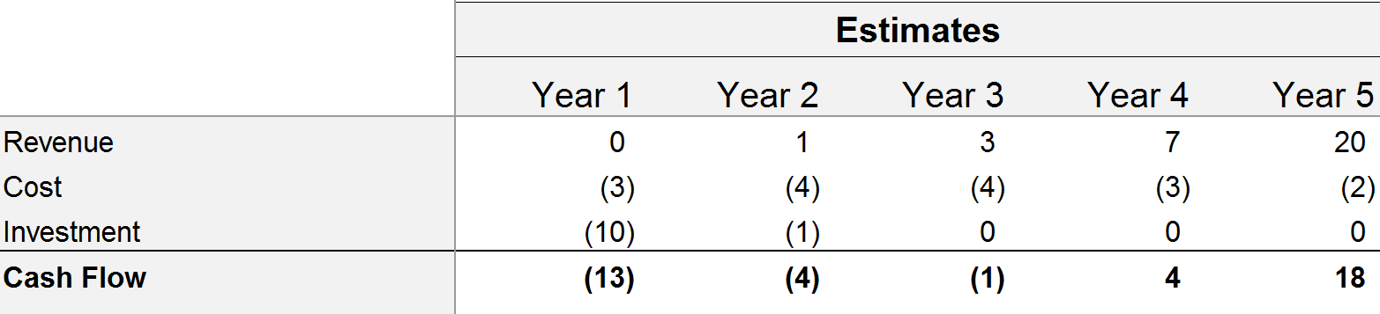
Net Present Value Step #1: Prepare cash flow forecast
Prepare cash flow forecast including investments required (cash outflow) and expected cash inflows. See example in table below:
Most cash flow forecasts are done on an annual basis, but you can construct quarterly or monthly cash flows if more detail is desired.
Often, cash flows for the first 1-2 years are negative as cash must be invested into starting up
The best practice is usually to estimate cash flow over a 3-5 year period
Year 0 is the present day, and Year 1 is the first year. This is important because cash flows derived in Year 1 must be discounted back to year 0 to find the present value. Cash flows are generally assumed to occur at the end of the period or midway through the period

Slide 51
Net Present Value Step #2: Define Discount Rate
Define Discount Rate, that is to say the rate used to discount net cash flows to present value.
A Company usually has standard assumed Discount Rate.
This Discount Rate is often calculated based on the Weighted Average Cost of Capital (WACC)
In our example, the Company has a Discount Rate (R) of 9%
R = 9%

Slide 52
Net Present Value Step #3: Calculate the Terminal Value
The Terminal Value, also called the Continuing Value, is used to show the remaining value of the project in the years beyond the last year shown in the estimated cash flows (In our example, after Year 5). To calculate it, apply this formula:
Cash Flow Future (CFF) is usually the average of the last 2 years of estimated cash flows
Cash Flow Future (CFF)
11
Terminal Value =
=
=
220
Discount Rate (R) - Growth rate (G)
9% - 4%
See step 2
Define an assumption for the growth rate of cash flow for the foreseeable future. This assumption can be derived from analyst reports or from industry historical data. Often, the long-term rate of inflation is used. Let’s use 4% in our example
As you can see, the Terminal Value makes up a substantial portion of the future value of the project making the assumptions you use in the calculation particularly important. Run sensitivity analysis on your Terminal Value assumptions to understand its impact on your results.

Slide 53
Net Present Value Step #4: Discount all future cash flows back to present day
Here is the formula:
1
NPV for year 1 =
Year 1 Cash Flow X
(1+ Growth rate)^{Period}
Year 1 is the period #1, Year 2 is the period #2, etc.

Slide 54
Net Present Value Step #5: Calculate the Total Net Present Value
Add all of the present values of the individual year cash flows together to arrive at the Total Net Present Value
Total NPV
=
NPV for Year 1
NPV for Year 2
NPV for Year 3
NPV for Year 4
NPV for Year 5
NPV for Terminal Value
+
+
+
+
+

Slide 55
Table of Contents
Executive Summary
Business Opportunity & Suggested Solution
Project Objectives, Scope & Approach
Project Deliverables & Business Outcomes
Strategic Alignment
Dependencies & Constraints
Risk Assessment & Mitigation
Change Impact Assessment
Project Costs
Benefits
Net Present Value
Key Success Factors & KPIs
Exhibits

Slide 56
Key Success Factors & KPIs Replace this text by the key takeaway of this slide
The success criteria / KPIs that will be measured post-implementation to demonstrate how the project delivered on its objectives and benefits are shown in the table below:
KPI | Current State | Target State
E.g. Increase Net Promoter Score (NPS) | 87% | 90%
Insert your own text | Insert your own description | Insert your own description
Insert your own text | Insert your own description | Insert your own description
Insert your own text | Insert your own description | Insert your own description
Insert your own text | Insert your own description | Insert your own description
Insert your own text | Insert your own description | Insert your own description

Slide 57
Table of Contents
Executive Summary
Business Opportunity & Suggested Solution
Project Objectives, Scope & Approach
Project Deliverables & Business Outcomes
Strategic Alignment
Dependencies & Constraints
Risk Assessment & Mitigation
Change Impact Assessment
Project Costs
Benefits
Net Present Value
Key Success Factors & KPIs
Exhibits

Slide 58
Insert the title of the first Exhibit Summarize the key message of this slide
Try to keep the Business Plan as succinct as possible.
When a topic is not essential, put it in the Exhibit section.

Slide 59
Insert the title of the second Exhibit Summarize the key message of this slide

Slide 60









Interested in more Business & Consulting Toolkits? Our ex-McKinsey, Deloitte & BCG Consultants created 10 Toolkits including practical Frameworks, Tools & Templates
1.Corporate & Business Strategy Toolkit
2.Management Consulting Toolkit
3.Change Management Toolkit
4.Project Management Toolkit
5.Sales, Marketing & Communication Toolkit
Visit Website
Visit Website
Visit Website
Visit Website
Visit Website
6.Finance and Mergers & Acquisitions Toolkit
7.Digital Transformation Toolkit
8.Operations & Supply Chain Toolkit
9.Leadership Skills Toolkit
10.Legal Toolkit
Visit Website
Visit Website
Visit Website
Visit Website
Visit Website

Slide 61

Interested in multiple Business & Consulting Toolkits? Get access to all our Toolkits for half the price with the Gold Business & Consulting Package
Gold Business & Consulting Package
Learn More
www.slidebooks.com

Slide 62



Need more help? Hire one of our Management Consultants for $4,000 a day
Learn More

Slide 63
Thanks for your attention!
www.slidebooks.com

